Slide 1

When your computer starts up, select English system option.

Slide 2
Database Management
COMP3010E FALL 2025
Lab 1 ER/EER Diagram and Relation Schema

Slide 3
Notes
The lab sessions will be hands-on, with explanations as we go. After the lab, you need to complete the lab report.
Please note, the requirements for the lab and the Homework (already posted in QQ group) are different, so don’t confuse them.
The deadline for submitting the lab is October 9th midnight. You need to submit both your lab report (word format) and the exported .dia source file. No late submission will be accepted.
Please email your deliverable as a ZIP FILE to the email: zhouxun2023@hit.edu.cn and Put "[COMP3010E] Lab1 <Your Name>" in the email subject. Also please include your student ID number in email.

Slide 4
Agenda
Experiment Preparation
  Download of DIA (optional)
  Basic usage of DIA
Design and Drawing of ER and EER Diagram (9 problems)
  Unary/Binary/Ternary relationship
  Weak entities
  Composite/Multivalued attribute
  Superclass and subclass
Conversion from ER/EER Diagram to Relation Schema
Normalization

Slide 5
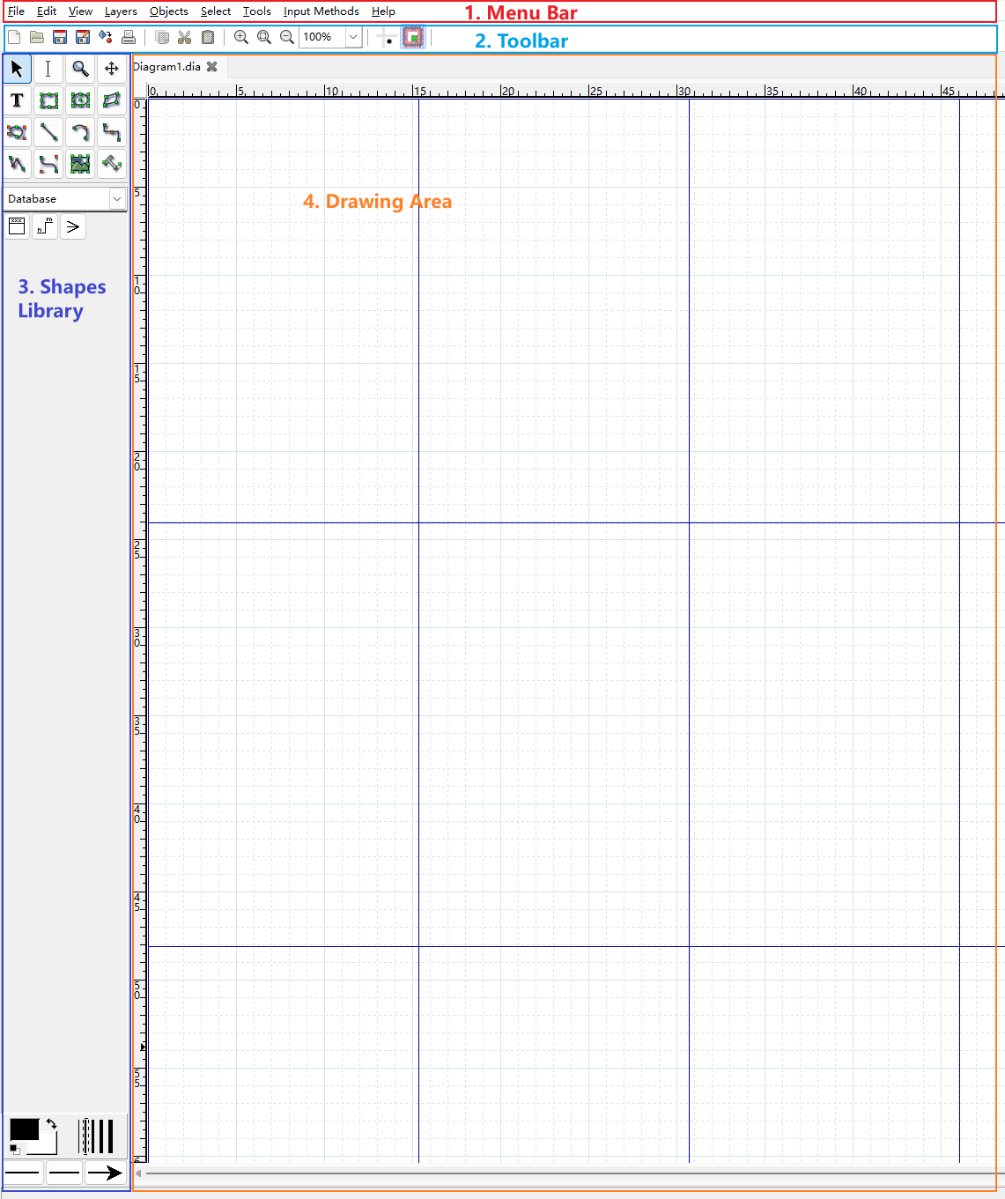
Task 1. Preparation
Download DIA from: http://dia-installer.de/download/index.html
Install DIA
Basic element in DIA
  Menu Bar
  Toolbar
  Shapes Library
  Drawing Area(Worksheet)

Slide 6
Task 1. Preparation
Basic usage of DIA
Create an entity
Add some properties to the empty entity
  add primary key
  add non unique attributes
Add relations to the ER diagram

Slide 7
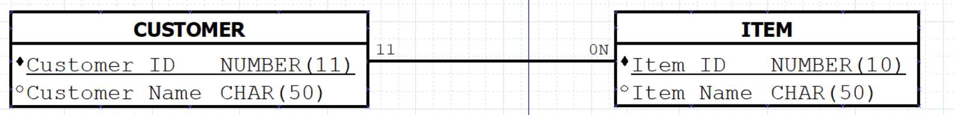
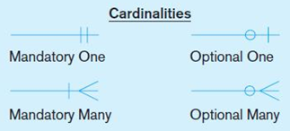
Notice
Directly mark cardinalities.
(Lab session)
Crow’s foot notation.
(Class)
Due to DIA limitations and for briefness, the representation of relationships in the lab is much simpler, not following the crow's foot notation.
For future exams and homework, please stick to the method we went over in class.

Slide 8
Task 2.
Design and Drawing of ER/EER Diagram
Unary relationship
Binary relationship(one to one, one to many, many to many)
Ternary relationship
Weak entities
Composite attributes
Multivalued attributes
Superclass and subclass

Slide 9
Problem 1. Unary relationship
Business Rules
An employee supervises other employees and an employee is supervised by one supervisor only.
Solutions
Step 1. Create an entity EMPLOYEE.
Step 2. Add attributes to the entity EMPLOYEE.
Step 3. Add a relationship between employees and supervisors.
Step 4. Edit the minimum and maximum cardinalities for the relationship.(try yourself)

Slide 10
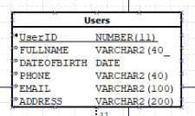

Problem 2. Binary relationship(1 to 1)
Business Rules
Each user has at most one login account, and each account is linked to exactly one user. In some cases a user may not yet have an account, but once an account exists it must correspond to exactly one user.

Slide 11
Problem 3. Binary relationship(1 to many)
Business Rules
A customer may order an item or more than one item but each item must be ordered by one and only one customer. Company wants to keep track of who is buying what and when.
Solutions
Step 1. Draw the entities and relationship as usual.
Step 2. Solve the “keep track of” part.

Slide 12
Problem 4. Binary relationship(many to many)
Business Rules
A Customer may do business in one or more territories but a territory should have at least one customer.
Solutions
Since this is a many to many relationship, it needs an Associative Entity (AE) to keep track of who is doing business in what territory. So we add an AE and change the relationship from the AE to other entities as many to one.

Slide 13
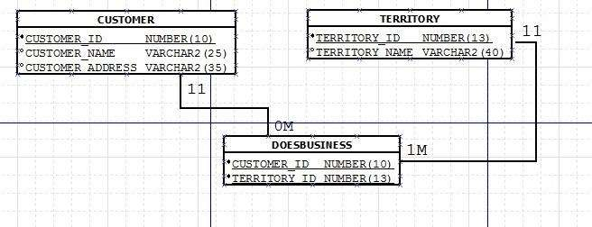
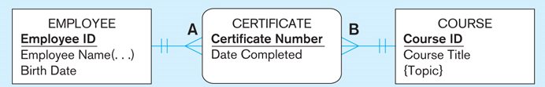
Notice
For briefness, in the lab, the Associative Entity includes the primary key of the related entities.
However, the Associative Entity in class includes attributes specific to relationship instances.
For future exams and homework, please stick to the method we went over in class.
Associative Entity. We add Customer_Id and Territory_id from two related entities to AE as its composite primary key.
(Lab session)
Associative Entity. CERTIFICATE has attributes specific to relationships, e.g., Date Completed.
(Class)

Slide 14
Problem 5. Ternary relationship (many to many)
Ternary relationships are 3 entities participating in one relationship.
Business Rules
A patient can be treated by more than one physician, a physician can treat more than one patient, and one procedure can be applied by more than one physician to many patients.

Slide 15
Business Rules
A patient can be treated by more than one physician, a physician can treat more than one patient, and one procedure can be applied by more than one physician to many patients.
Solutions
For problem 4, we have converted the many-to-many relation to many-to-one relation by creating a new Associative Entity. We'll do something similar in this problem as well.
Specifically, we call the Associative Entity Patient_Management. The primary keys for this entity that will keep every row unique are Physician_ID, Patient_ID, Procedure_ID, Date, Time.
That is to say, one physician can treat one patient with one procedure on a certain date and at a particular time.

Slide 16
Practice time
We've roughly addressed the first five problems, including how to draw ER diagrams for unary, binary, and ternary relationships…
Please use the computers in the lab or your personal laptops to try out the tasks we just covered.
We’ll continue with the next part of the experiment in the next class.

Slide 17
Problem 6. Weak entities
A weak entity is an entity that does not exist without a strong entity.
For example, if an employee does not exist then his/her dependents do not exist, but an employee can exist without any dependents.
In this case dependents are weak entities and employee is a strong entity.
We have shown how to create a strong entity before, next we walk through how to draw a weak entity.

Slide 18
Problem 7. Composite attribute
In this case, we will use EMPLOYEE as our entity.
Attributes for this entity are Employee_ID, Employee_Name and Hire_Date. Employee_Name is a composite attribute.
It can be further broken down into First Name, Middle Name and Last Name attributes.

Slide 19
Problem 8. Multivalued attribute
Employee phone numbers is a multivalued attribute.
We just represented the multivalued attribute with a pair of curly brackets.

Slide 20
Problem 9: Superclass and subclasses
Business Rules
There are a number of researchers in a team. Researchers are mainly composed of supervisors, clinicians, and programmers. Each employee can have only one classification.
For all researchers, we store the employee ID, name, office room number, and office phone number.

Slide 21
Problem 9: Superclass and subclasses
Business Rules
A supervisor usually supervises several clinicians and/or programmers and some other research staff, but each researcher is supervised by only one supervisor.
We would also like to store the supervisor’s research interest, the clinician’s level, and the programmer’s years of experience. The clinician’s level is denoted by one of I, II, III, IV, and V.

Slide 22
Problem 9: Superclass and subclasses
Step 1. Create the superclass entity, namely RESEARCHER.
Step 2. Create 3 subclasses, namely SUPERVISOR, CLINICIAN and PROGRAMMER.
Step 3. Add the appropriate relationships between superclass and subclasses.
Let’s consider another scenario…

Slide 23
Problem 9: Superclass and subclasses
Business Rules
There are a number of researchers in a team. Researchers are mainly composed of supervisors, clinicians, and programmers. Each employee can have one or more classification.
For all researchers, we store the employee ID, name, office room number, and office phone number.
Solution
The discriminator attribute is treated as a composite attribute. Each component is a Boolean variable (Y/N).

Slide 24
Problem 9: Superclass and subclasses
Summary
Composite attribute such as Name or CLASSIFICATION under an overlap condition: () Round brackets
Multivalued attribute such as phone number: { } Curly brackets
Pre-defined value such as Clinician level: [ ] Square brackets
Discriminator attribute such as CLASSIFICATION under a disjoint condition: No brackets

Slide 25
Practice time
We've roughly addressed the last four problems in TASK 2, including how to represent weak entities, composite attributes, and multivalued attributes, as well as how to handle superclass and subclasses…
Please use the computers in the lab or your personal laptops to try out the tasks we just covered.
We’ll continue with the next part of the experiment in the next class.

Slide 26
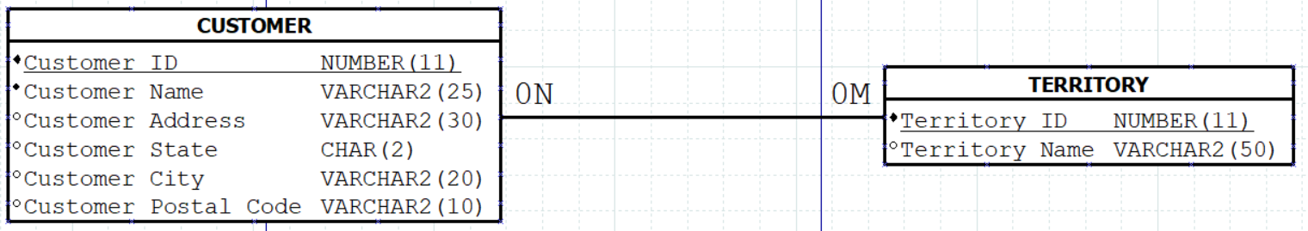
Task3. Conversion from ER/EER Diagram to Relational Schema
Business Rules
A customer can do business in multiple territories and a territory can have multiple customers.

Slide 27
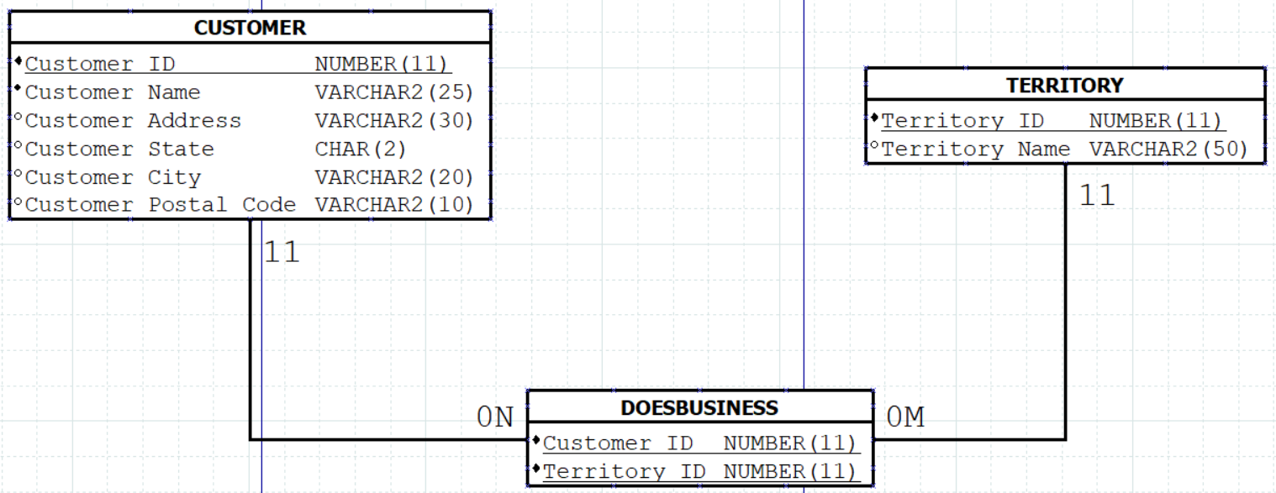
Business Rules
A customer can do business in multiple territories and a territory can have multiple customers.
Solution
Since, this is a many to many cardinality, we need an associative entity (AE) to track which customer is doing business in what territory.

Slide 28
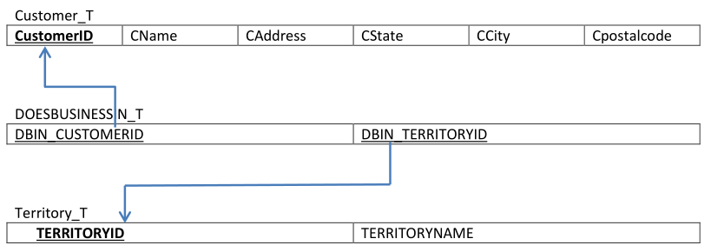
Task3. Conversion from ER/EER Diagram to Relational Schema
We get the corresponding relational schema as follow.
Reference ID arrows are always pointed from a Foreign key to the primary key of another table to which it is referencing.

Slide 29
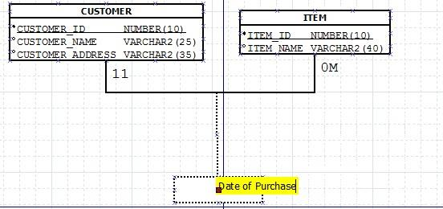
Task3. Conversion from ER/EER Diagram to Relational Schema
Another scenario
In cases where a relationship itself has attributes, the conversion to relational schema requires an additional relation.
Business Rules A customer may order an item or more than one item but each item must be ordered by one and only one customer. Company wants to keep track of Date of Purchase between CUSTOMER and ITEM.

Slide 30
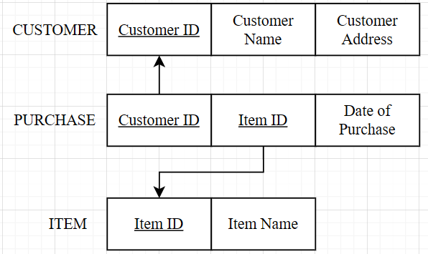
Business Rules A customer may order an item or more than one item but each item must be ordered by one and only one customer. Company wants to keep track of Date of Purchase between CUSTOMER and ITEM.
Solution 1 A new relation (e.g., PURCHASE) will be created, containing the primary keys of the participating entities (CUSTOMER_ID, ITEM_ID) as a composite primary key, together with the relationship attribute (Date_of_Purchase). This enforces that one CUSTOMER can only buy the same ITEM once.

Slide 31
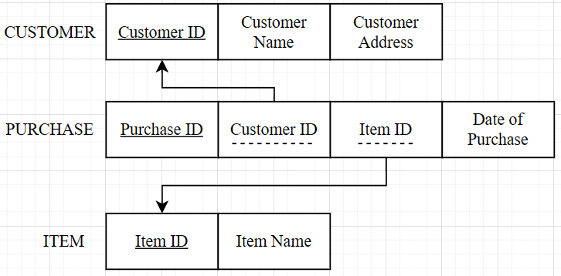
Business Rules A customer may order an item or more than one item but each item must be ordered by one and only one customer. Company wants to keep track of Date of Purchase between CUSTOMER and ITEM.
Solution 2 However, if multiple purchases of the same ITEM by the same CUSTOMER are allowed, it is often better to introduce a surrogate key (e.g., PURCHASE_ID) as the primary key of the PURCHASE table. In this case, CUSTOMER_ID and ITEM_ID become foreign keys rather than forming the composite primary key.

Slide 32
Task4. Normalization Example
There are four normal forms under this course.
  0NF- If an entity has multi-value or composite attributes then it is in 0 normal form.
  1NF- If an entity does not have any multi-value or composite attributes, but it has partial dependency/ies, then it is in 1st normal form.
  2NF- If an entity does not have any multi-value or composite and partial dependency/ies, but has transitive dependency/ies, then it is in 2nd normal form.
  3NF- If an entity does not have any multi-value or composite and partial and transitive dependency/ies and all its non-unique attributes depend on primary key(composite or single) , then it is in 3rd normal form.
Let's use one example to explain these.

Slide 33
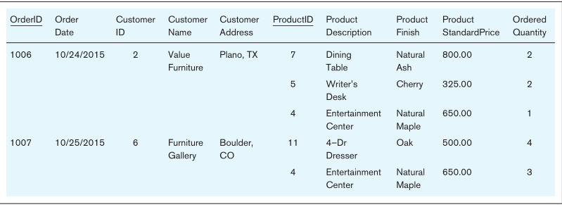
Task4. Normalization Example
Here is a single table which represents the customer invoice from a company, with the attributes recorded as column headings.

Slide 34
Firstly, check if there are any multi-value attributes present in this entity.
For example, Product ID is a multivalued attribute, so the relation is not in first normal form.
0NF- If an entity has multi-value or composite attributes then it is in 0 normal form.

Slide 35
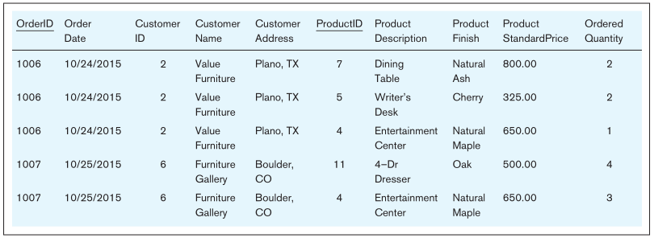
We'll eliminate the multivalued attribute and create a new table.
Now, this entity INVOICE has a composite primary key (OrderID, ProductID) because there is only one row in the table for any combination of values for these attributes.
So, the relation is in first normal form (at least).
1NF- If an entity does not have any multi-value or composite attributes, but it has partial dependency/ies, then it is in 1st normal form.

Slide 36
However, the following partial dependencies exist, so the relation is not in second normal form.
(OrderID, ProductID) is the composite primary key of the entity.
However, the date on an order (OrderDate) is uniquely determined by the order number (OrderID) and has nothing to do with the ProductID!
partial
functional
dependency
  2NF- If an entity does not have any multi-value or composite and partial dependency/ies, but has transitive dependency/ies, then it is in 2nd normal form.
  A partial functional dependency exists when a nonkey attribute is functionally dependent on part (but not all) of the primary key.

Slide 37

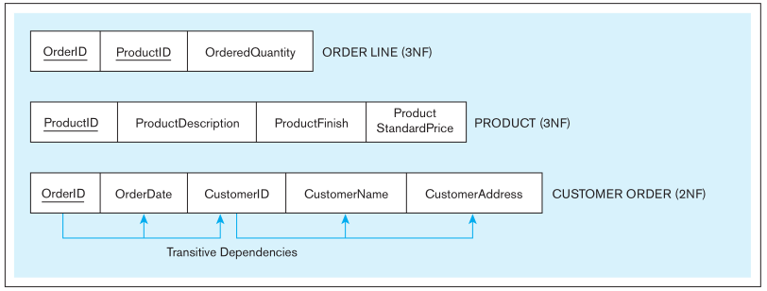
To convert it to second normal form, we create a new relation for each primary key attribute that is a determinant in a partial dependency.
Since OrderedQuantity is the only attribute that fully depends on the composite primary key (OrderID, ProductID), we also create a new relation for this.
However, there exist transitive dependencies in CUSTOMER ORDER relation. Thus, the CUSTOMER ORDER is in second normal form instead of third normal form.
3NF- If an entity does not have any multi-value or composite and partial and transitive dependency/ies and all its non-unique attributes depend on primary key (composite or single) , then it is in 3rd normal form.
A transitive dependency in a relation is a functional dependency between the primary key and one or more nonkey attributes that are dependent on the primary key via another nonkey attribute.

Slide 38
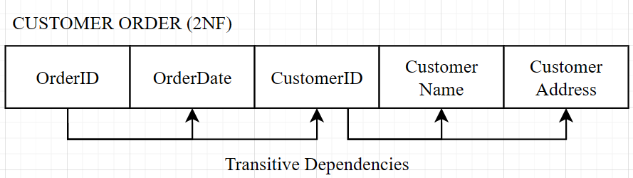
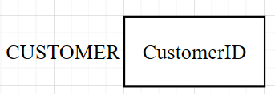
We can easily remove transitive dependencies from a relation by means of a three-step procedure:
Step 1. For each nonkey attribute that is a determinant in a relation, create a new relation. That attribute becomes the primary key of the new relation.
create a new
relation

Slide 39
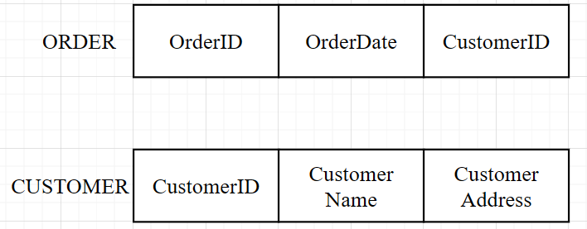
Step 2. Move all of the attributes that are functionally dependent only on the primary key of the new relation from the old to the new relation.
move CustomerName, CustomerAddress from CUSTOMER ORDER to CUSTOMER

Slide 40
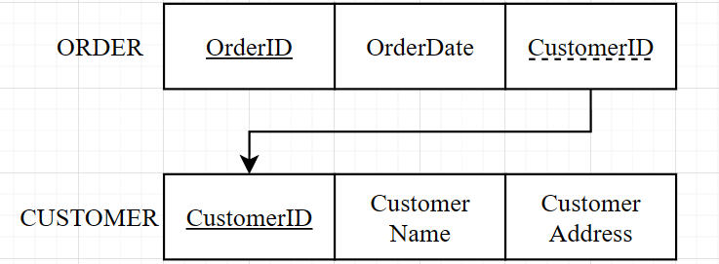
Step 3. Leave the attribute that serves as a primary key in the new relation in the old relation to serve as a foreign key that allows you to associate the two relations.
keep CustomerID (primary key in CUSTOMER) reserved in ORDER to associate the two tables
3NF

Slide 41
Practice time
We've roughly addressed the last two Tasks, including conversion from ER/EER to relational schema, and normalization of relation.
Please use the computers in the lab or your personal laptops to try out the tasks we just covered.

Slide 42
Practice time
Sign-in
Q&A
If you have finished all the lab tasks, you could leave the classroom quietly. Make sure to complete the lab report and submit it on time.

